Slide 1
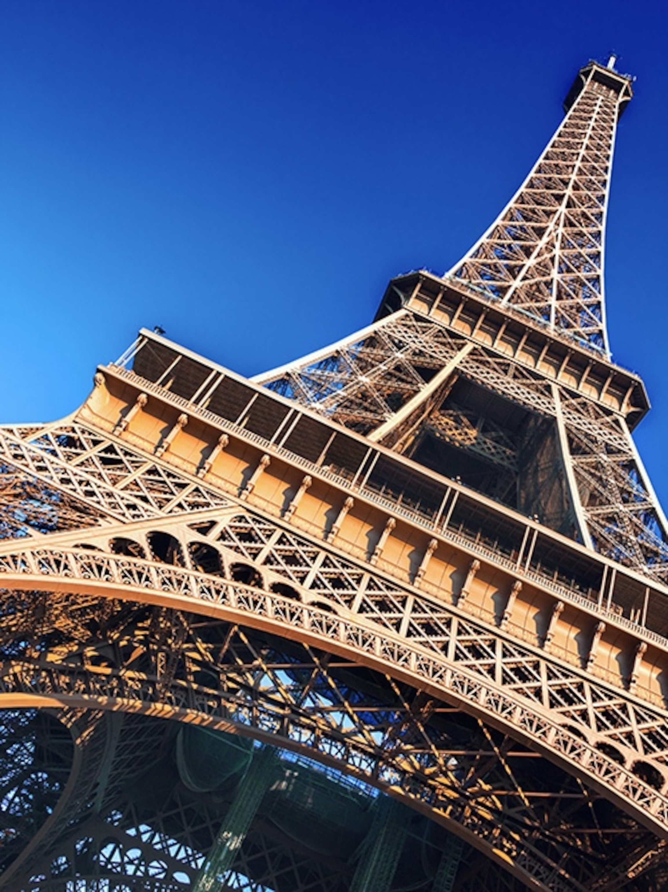
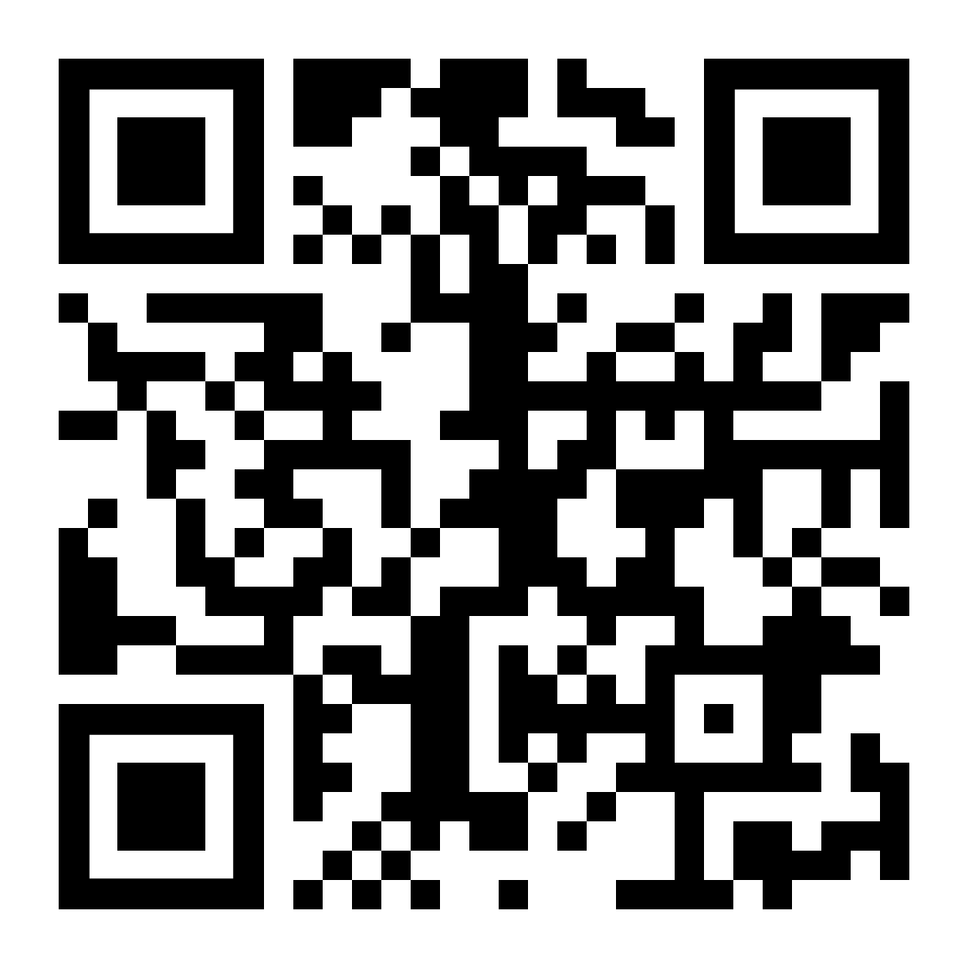
Avez vous Valentines Day
fun with our virtual
balloon race
from Paris
£4
each
Launch Noon 14th February
from the Eiffel Tower
Go to https://ecoracing.co/user/page/???
right now and buy lots of balloons for
UK Poverty Charity

Slide 2
Valentines Day
virtual balloon race
fun from Rome
£4
each
Launch Noon 14th February
from the Trevi Fountain
Go to https://ecoracing.co/user/page/???
right now and buy lots of balloons for
UK Poverty Charity

